Slide 1

Resource Allocation Tool
Design and Optimization Modeling of Carbon Mitigation InterventioNs In health faCilities
(DOMMINIC)

Slide 2
Project Overview: HIGH Horizons
Heat Indicators for Global Health: Surveillance, Early Warning Systems and adaptation-mitigation actions to reduce heat impacts in pregnant women, infants and health workers in the EU and Africa
Specific objectives
1. Identify and select suitable indicators for quantifying and monitoring the global, EU and national-level health impacts of extreme heat among pregnant and postpartum women, newborns and infants in Europe and sub-Saharan Africa

Slide 3
Project Overview: HIGH Horizons
2. Develop and test an Early Warning System using a smartphone app to provide individualized heat stress warnings, and locally adapted messaging for protecting pregnant and postpartum women, infants and health workers
3. Identify cost-effective, integrated adaptation-mitigation interventions to alleviate heat impacts on health workers, and to reduce carbon emissions associated with health care
4. Support global and EU climate policies and activities on the monitoring of direct and indirect impacts of climate change on health, and the strengthening of Early Warning Systems through guidance documents, and risk assessment and cost-benefit analysis tools

Slide 4
Aim of the Tool
To employ Atomica as a dynamic modelling tool to devise optimal strategies for carbon emission reduction within the High Horizons project.
Perform detailed carbon emission analysis – By utilizing Atomica, we will be able to model the carbon emissions of a specific healthcare facility and calculate a precise estimate of the central value of carbon emissions
Optimize resource allocation – Atomica will be instrumental in aiding decision-makers and implementers to effectively allocate resources towards carbon reduction activities. By modeling different scenarios, we can identify the most impactful interventions.
Facilitate user interaction – The project will ensure that Atomica's interface is user-friendly, making it accessible for all stakeholders involved.
Promote continual improvement – The flexibility of Atomica allows for the integration of new data, continually improving the performance of the tool and ensuring our modelling remains relevant and accurate. This process will allow us to continuously refine and adjust our carbon reduction strategies based on the latest data.

Slide 5
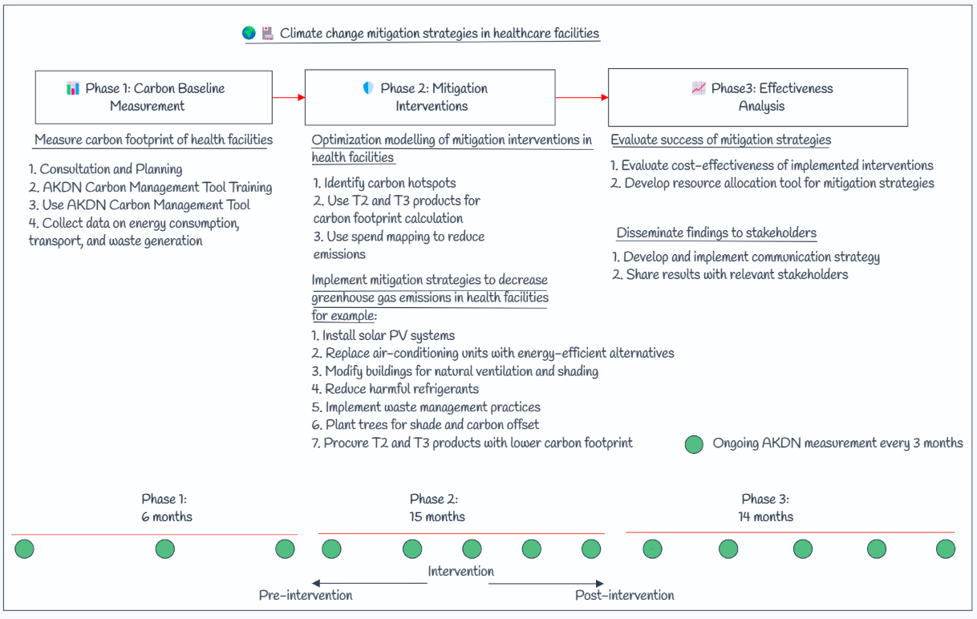

Carbon emission measurement, reductions and evaluation (HIGH Horizons)

Slide 6
Data Available for Use
The primary data for our carbon emissions modeling will be sourced from the AKDN emissions tool, enabling us to accurately capture the specific carbon footprint of our healthcare facilities.
The AKDN Carbon Management Tool is a web-based tool developed by the Aga Khan Development Network (AKDN) to help AKDN agencies and institutions measure, manage, and reduce their greenhouse gas (GHG) emissions.
The tool provides a comprehensive framework for tracking emissions across different sectors and activities, including buildings, transportation, and energy consumption.
It is designed to help AKDN entities identify opportunities to reduce their carbon footprint and implement strategies to achieve emissions reductions targets.
The tool includes modules for data collection, emissions calculation, target setting, and scenario analysis, as well as tools for reporting and communication.

Slide 8
Exploration of the Atomica structure
The model was based on the healthcare facility life cycle and consists of several compartments, including
Planning and Design, Construction, Operations, Maintenance & Repairs, Renovation & Expansion, and Decommissioning and Demolition.
It considered various sources of carbon emissions, such as energy, building & construction, transport & travel, anaesthetic gases, water, waste, inhaler, and procurement/supply chain.

Slide 9
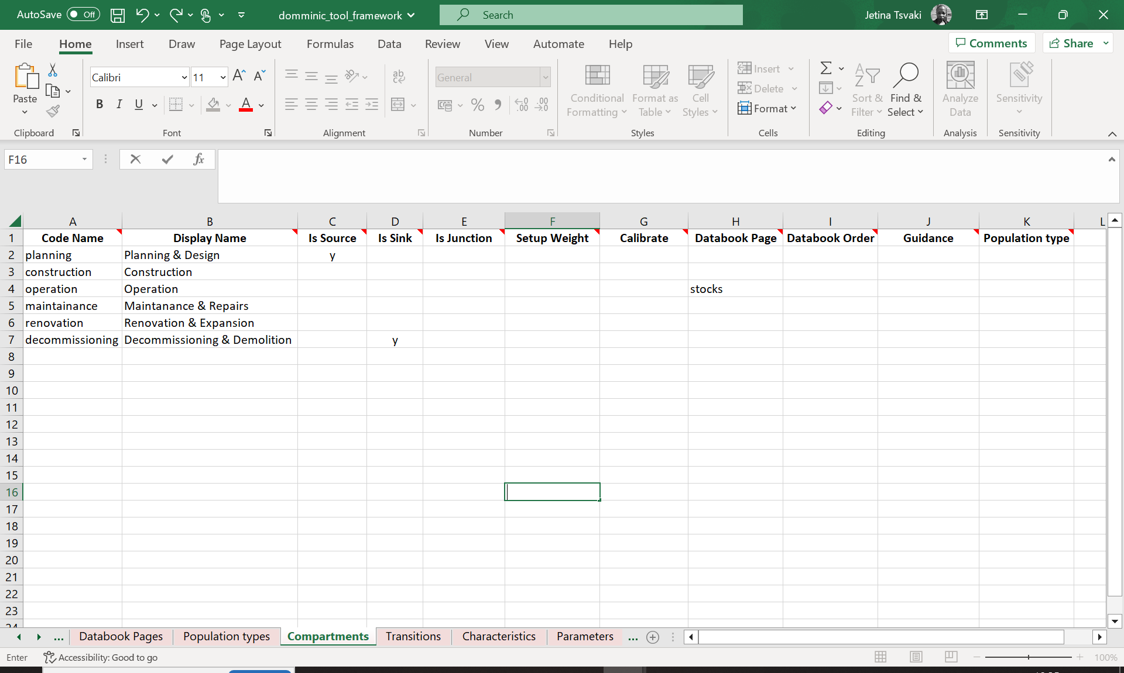

Slide 10
Concerns & Questions
We may not have rate or numbers associated with emissions in each compartment.
What is the minimum number of data points required for the tool to work
T1 : You can have as many or few pages as required in the databook? Uncertainty not automatically calculated in atomica rather manually,
T2: It is recommended that all parameter intended for explicit data calibration be placed on a single calibration sheet. Are not all parameters part of calibration ?, etc

